Slide 1
How do you read and analyze a work of Art?

Slide 2
Describe
Analyze
Interpret
Judge

Slide 3
Description
an explanation of exactly what you see…
what imagery is shown? what scene? what is happening? where/when is it happening? how many things are there?
what colors?
values?
shapes?
lines?
textures?
space?
(the elements of art)

Slide 4
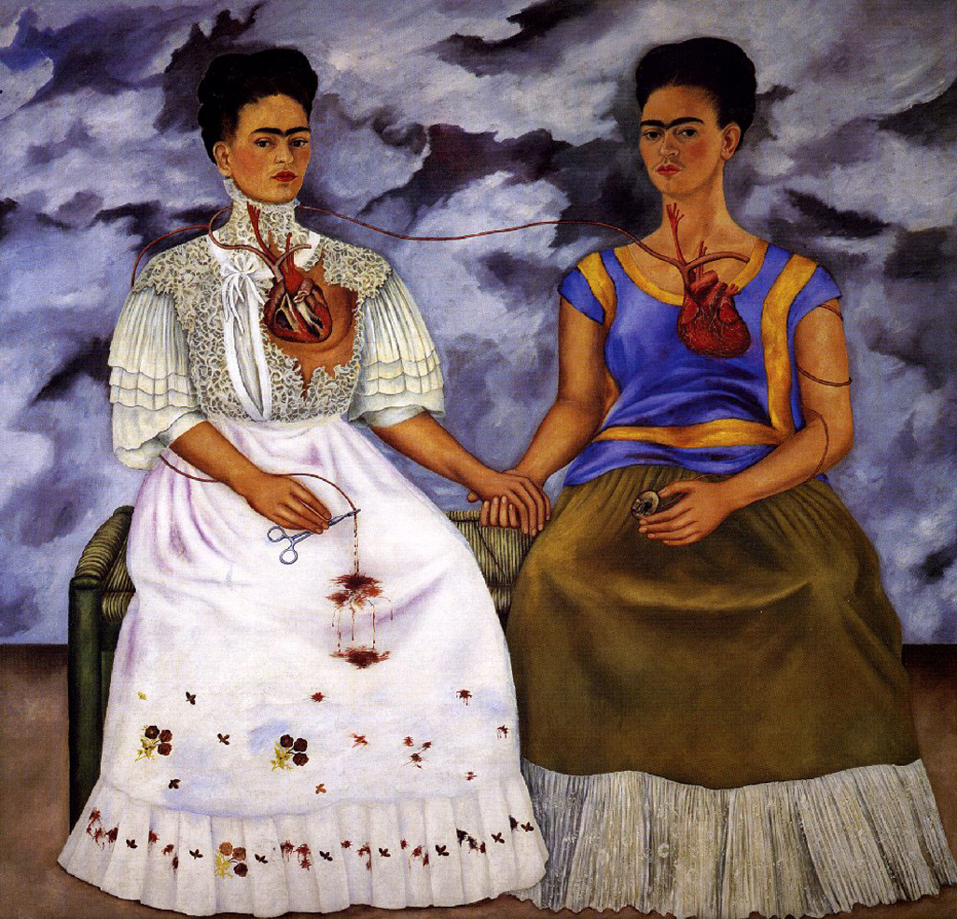
two identical women with olive skin, dark hair & dark eyes
one in wedding dress
one in casual dress
each has a heart on the outside of the body
women are seated
bench is green with straw seats
wall is covered with clouds
left woman has scissors
scissors drip with blood
right woman holds a picture
both women have the same hair and are seated in the same manner, holding each other’s hand
wedding dress is white with lace and red & yellow flowers around the bottom trim
casual dress includes a blue top with yellow stripes, a brown skirt with white lace

Slide 5
Analysis
how & why the work of art is organized…
(what is the mood or scene and how is it created?)
how/why is proportion used?
how/why is contrast used?
how or why is any part emphasized?
how/why is repetition/pattern used?
how/why is rhythm/movement used?
how/why is the piece balanced?
how/why is the piece unified?
(the principles of design)
Use the elements of art to help explain!

Slide 6
repetition of woman creates unity by repeating an image
symmetrical balance and holding of hands creates stability
the hand holding creates unity between the two figures
the differing dress creates contrast between the two figures
the two figures are similar but different, indicating a contrast and balance
there is a fancy dress and a casual dress (status vs. common?)
the red hearts are emphasized by contrasting the cool colors in the dresses and background
dark clouds and mysterious gaze creates an ominous mood

Slide 7
Interpretation
what you think the work means
how do you read the work of art?
what does the imagery mean, or say?
what was the artist trying to say?
what is being depicted?
what story is the work of art telling?
how does the work of art affect a viewer?

Slide 8
this is the same woman dealing with the two different sides of her personality or lifestyle
she has been wealthy and poor, happy and sad, healthy and ill
she wears her heart on her sleeve, meaning she is passionate and caring
what else?
what about the scissors?
what about the portrait?
who is she? or are they?

Slide 9
Judgment
is the work of art good?
quality… is it good or bad? why, why not?
what it an important work of art?
was the artist successful at his/her intended meaning?
preference… do you like it? why, why not?
does it appeal to your taste (aesthetic preference)?
would you hang it in your home?
has your initial response to this work of art changed?

Slide 10
this work of art is successful because it is a glimpse into the personal life of an individual in a very intense manner
the artist was successful in causing the viewer to contrast and compare the two women

Slide 11
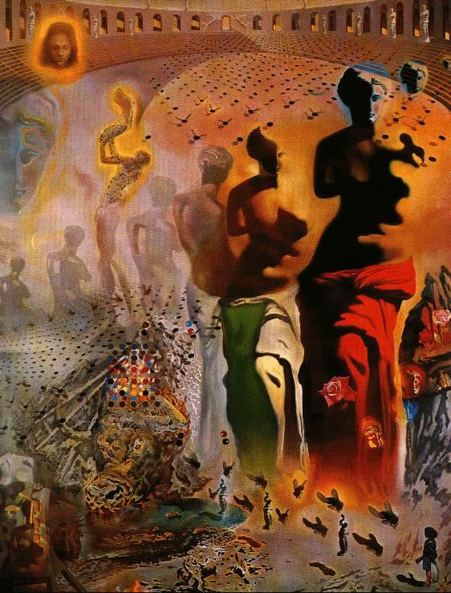

Slide 12
Salvador Dali
Salvador Domingo Felipe Jacinto
Dalí i Domènech, 1st Marquis of Púbol
Spanish • 1904-1989
Surrealistic Painter
• striking and bizarre imagery
• eccentric, excessive lifestyle
• artistic repertoire includes:
painting, printmaking, drawing, film,
sculpture, photography, collaboration
The Hallucinogenic Toreador, 1970
13’ x 9.75’ (oil on canvas)
fyi. Picasso’s full name:
Pablo Diego José Francisco de Paula Juan Nepomuceno María de los Remedios Cipriano de la Santísima Trinidad Ruiz y Picasso

Slide 13
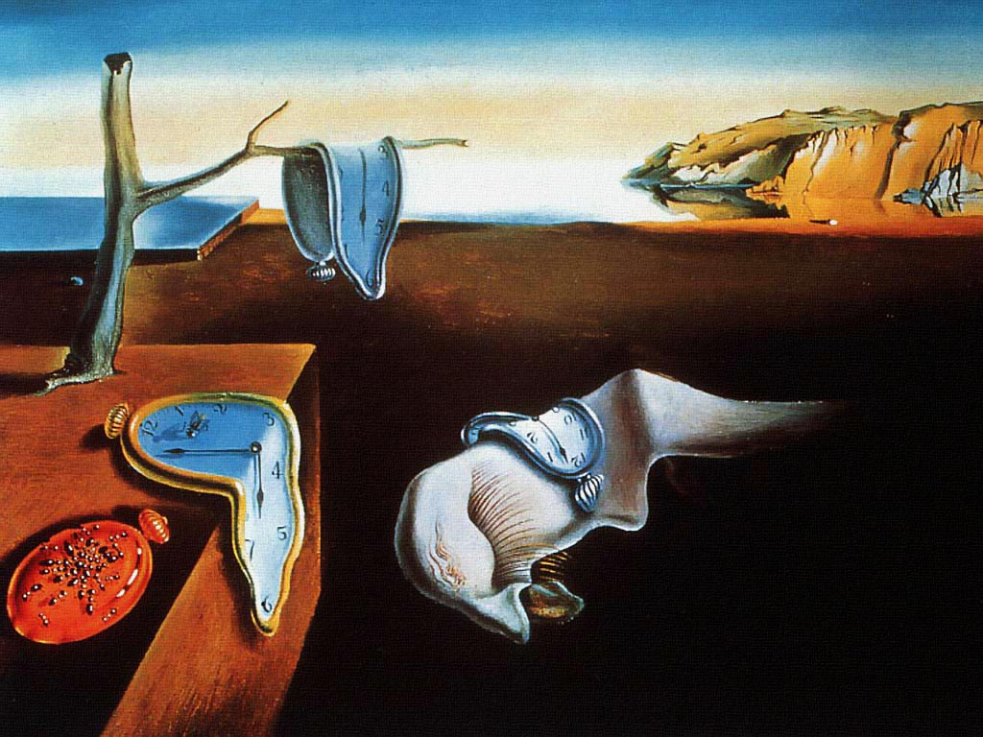
The Persistence of Memory, 1931 (oil on canvas) 9 ½” x 13”

Slide 14
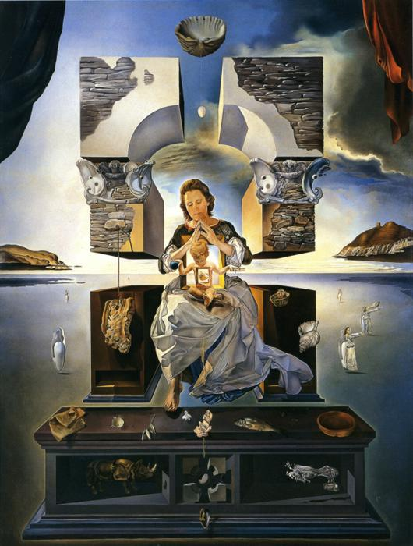
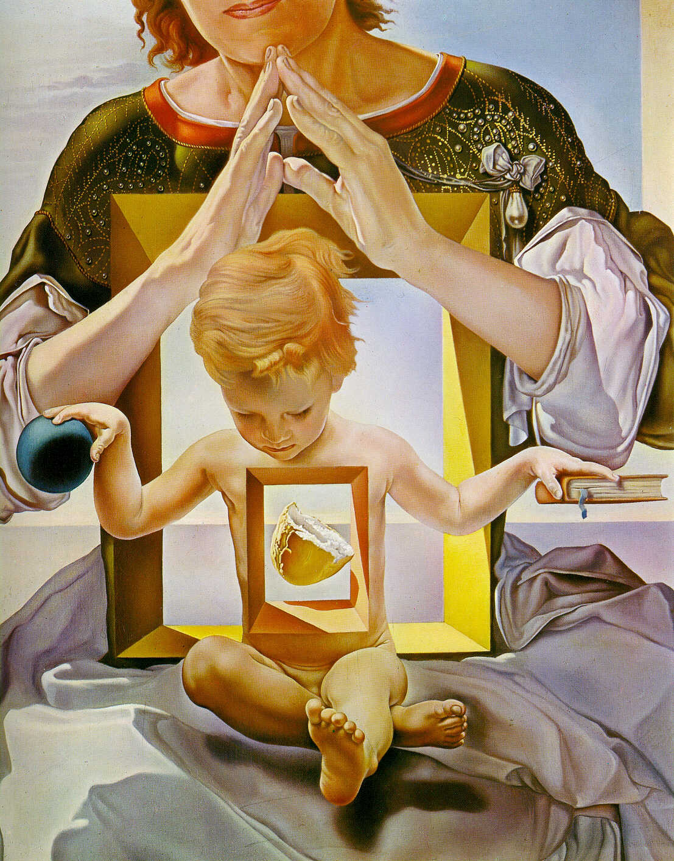
(detail)
The Madonna of Port Lligat, 1950 (oil on canvas)

Slide 15
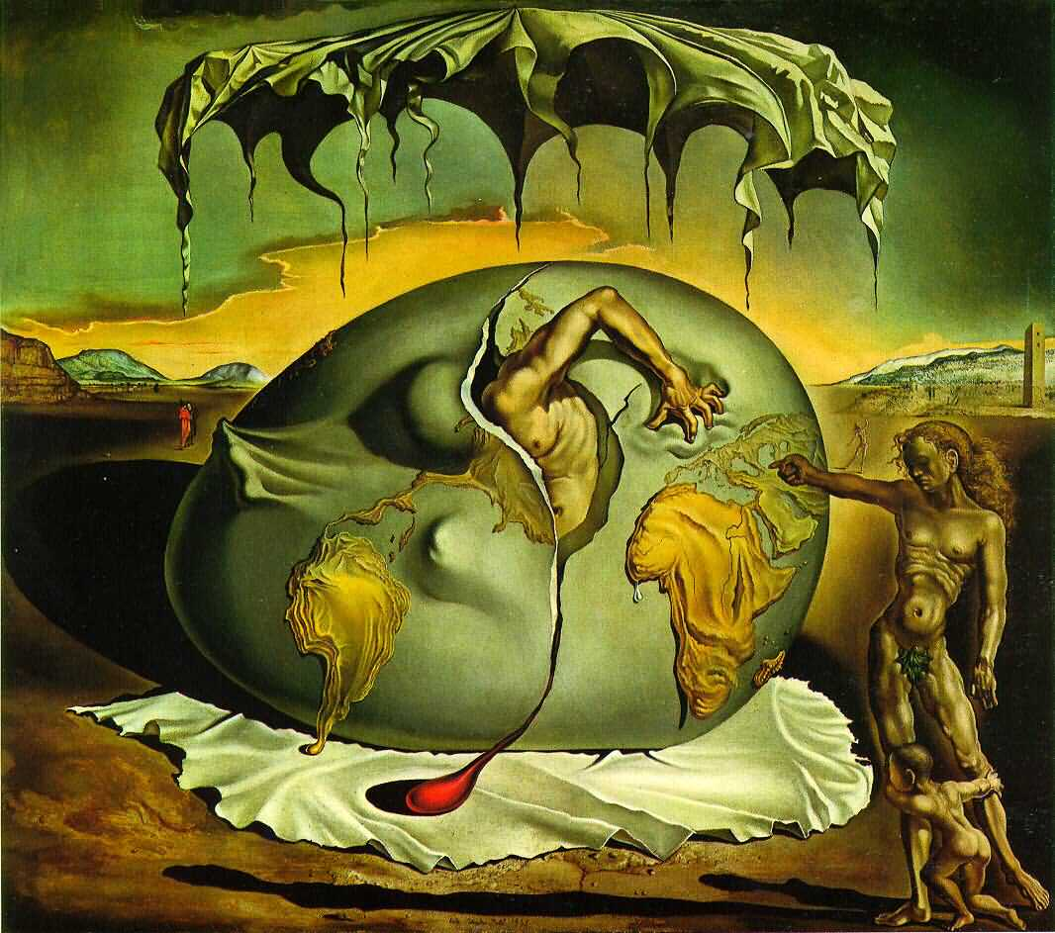
Geopoliticus Child Watching the Birth, 1943 (oil on canvas)

Slide 16
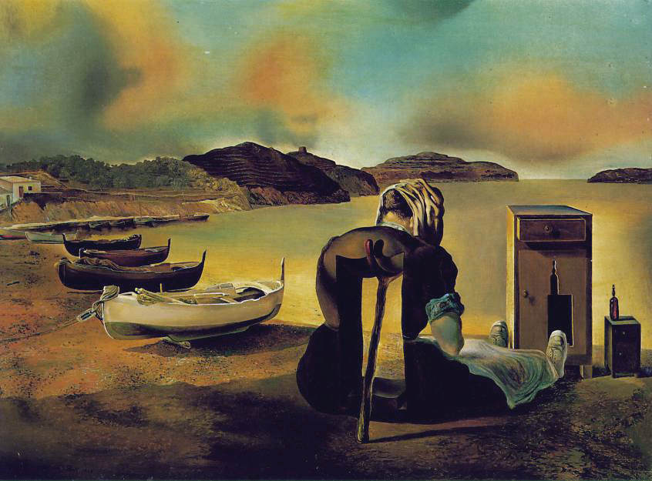
The Weaning of Furniture-Nutrition, 1934 (oil on panel) 7” x 9 ½”

Slide 17
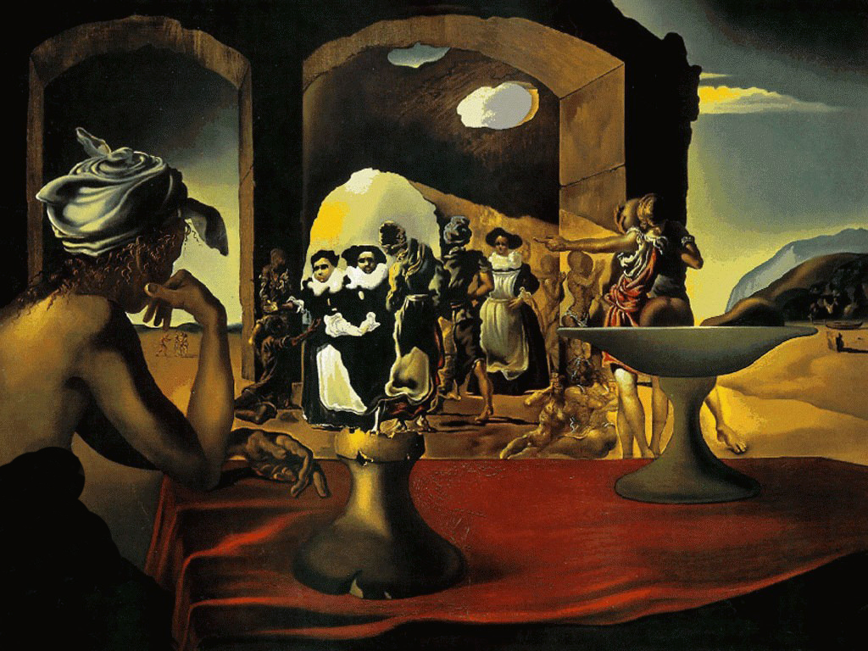
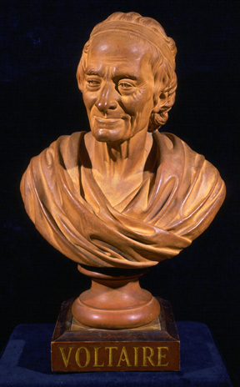
Portrait Bust of Voltaire (Francois Marie Arouet)
19th Century
terracotta
Slave Market with Disappearing Bust of Voltaire, 1940
(oil on canvas) 18.5” x 26”

Slide 18
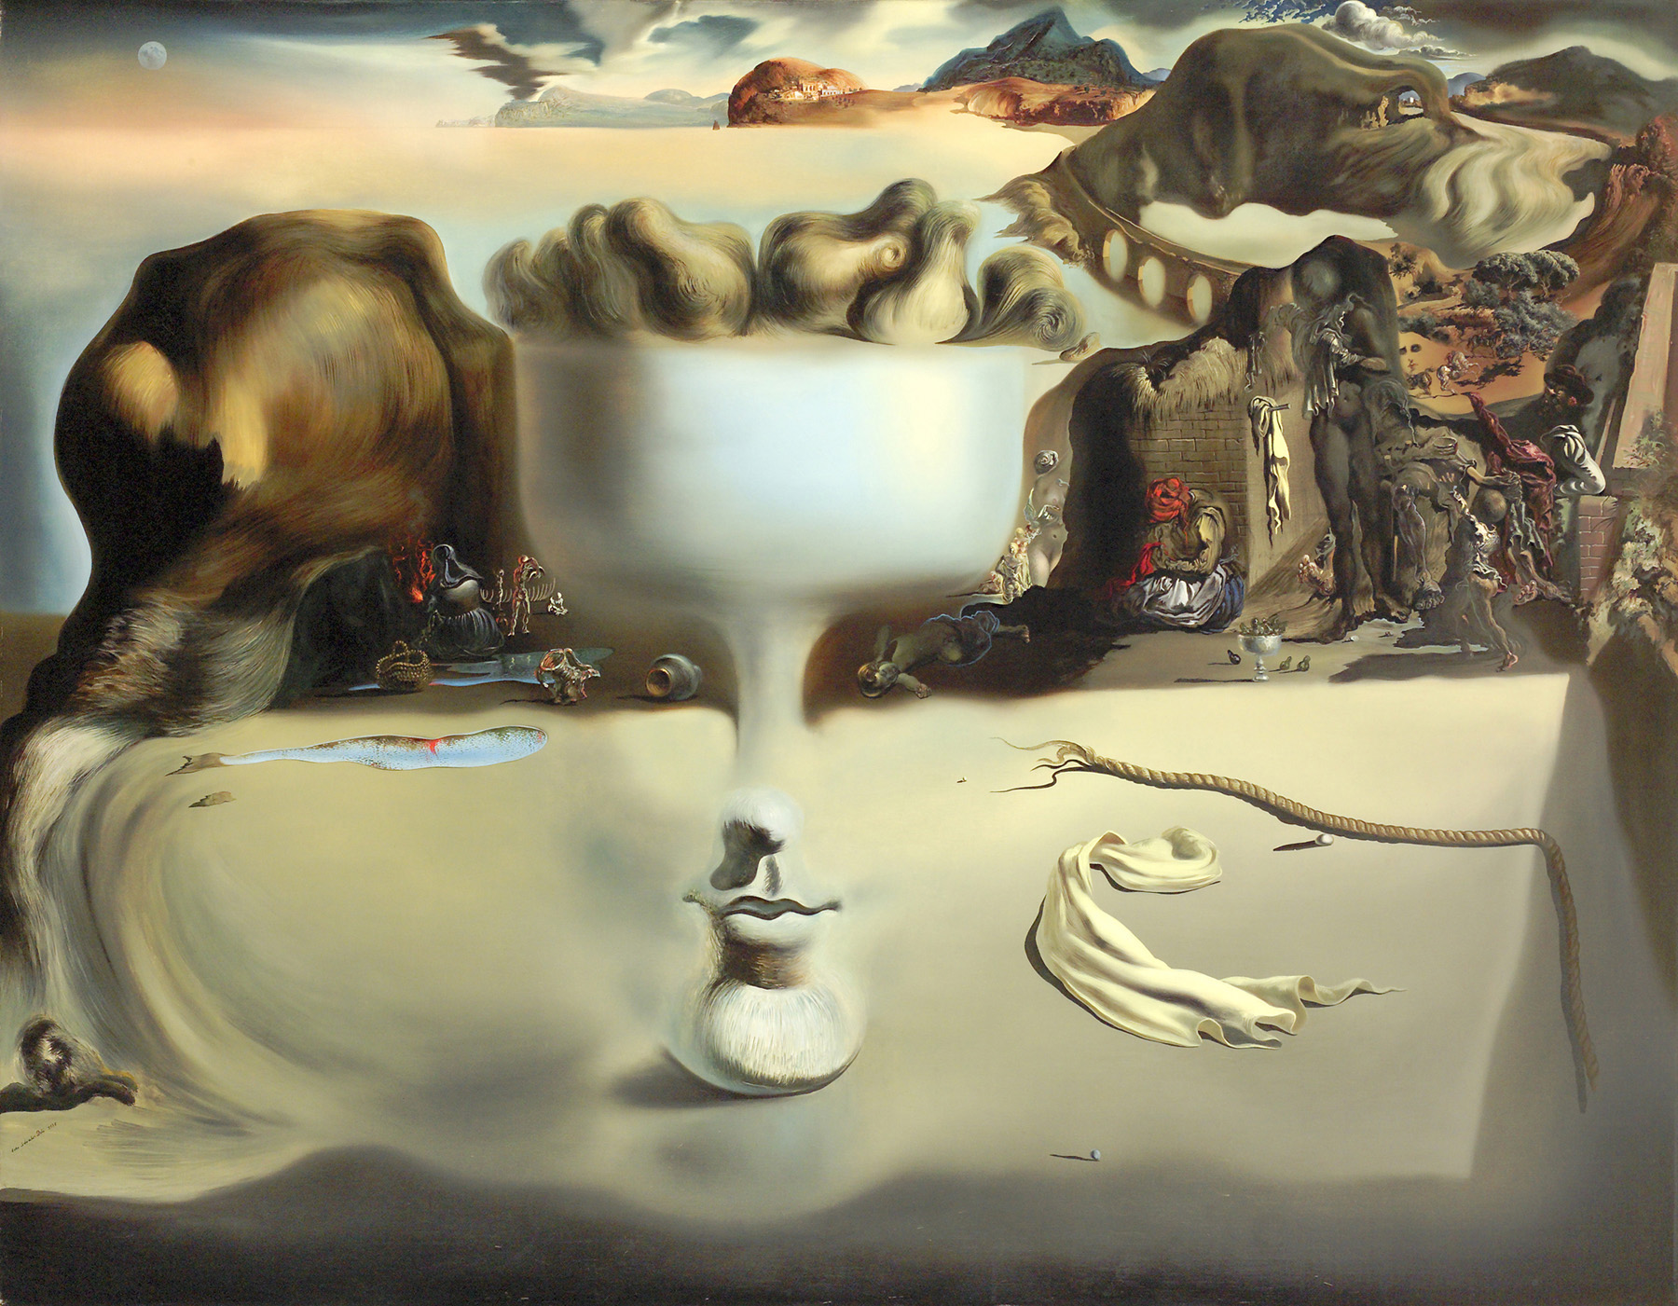
Apparition of Face and Fruit Dish on a Beach, 1938 (oil on canvas) 45” x 57”

Slide 19
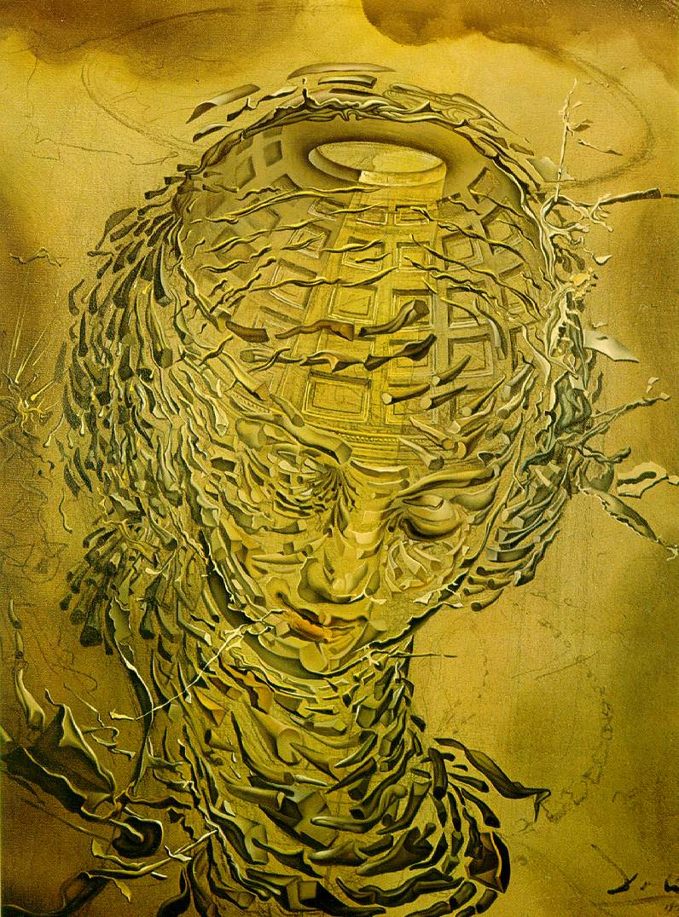
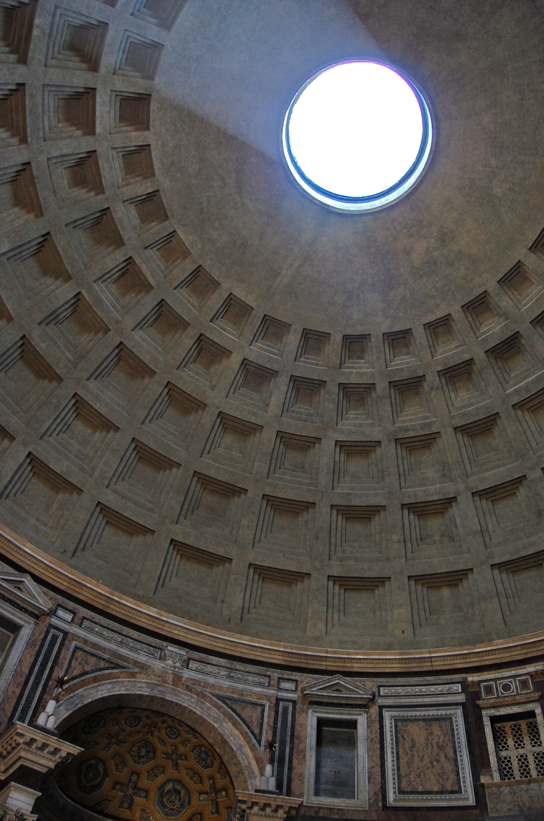
Oculus and Dome of Pantheon in Rome
(where Raphael is buried)
Exploding Raphaeleque Head, 1951

Slide 20
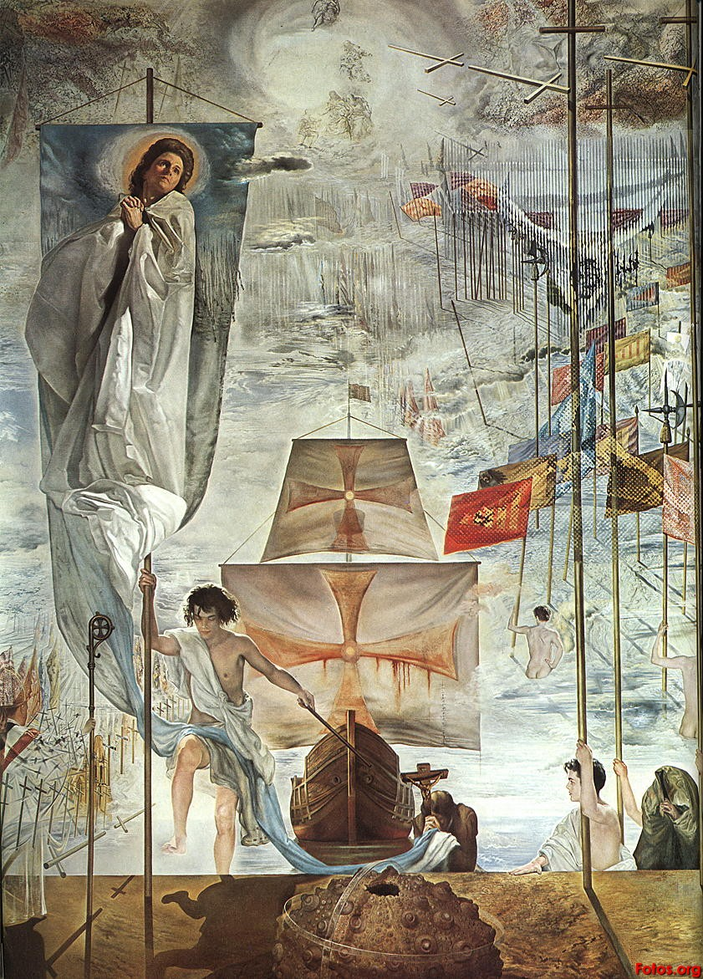
The Dream of Christopher Columbus,
1958-1959
(oil on canvas)
14’ x 9’

Slide 21
So, what is
Surrealism?

Slide 22
• inspired by fantasy and subconscious
• incongruous & unexpected juxtapositions
• expressing unconscious thoughts and feelings
• illogical, dreamlike imagery
• often distorting the form of ordinary object and placing
them in new contexts

Slide 23
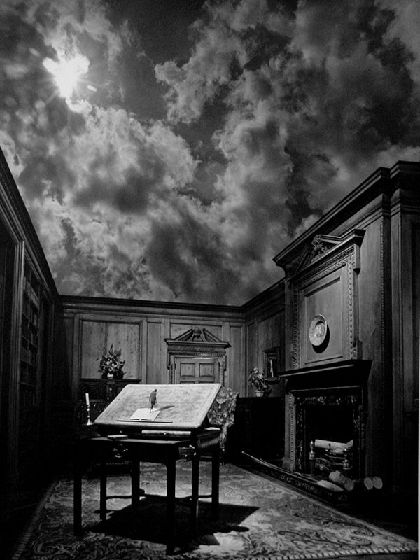
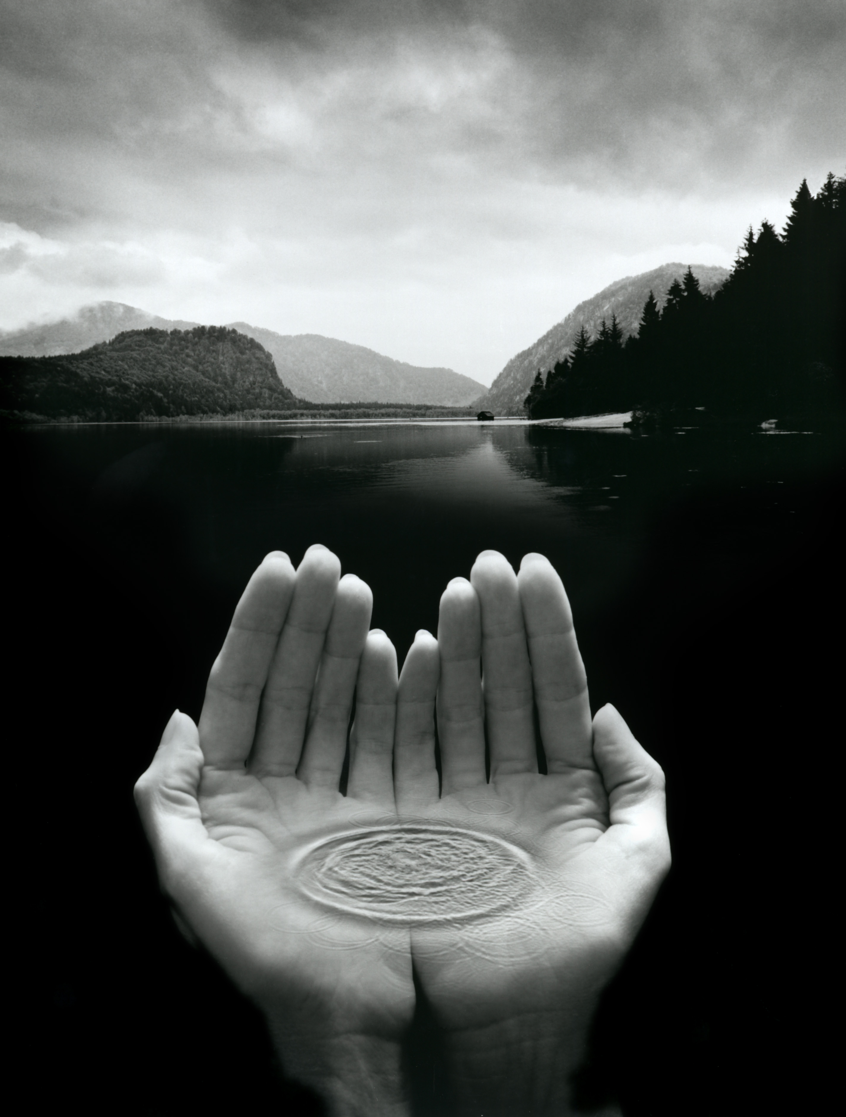
Jerry Uelsmann
Alchemist of the Photographic Process
1934-present

Slide 24
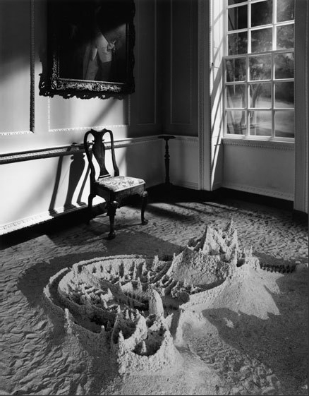
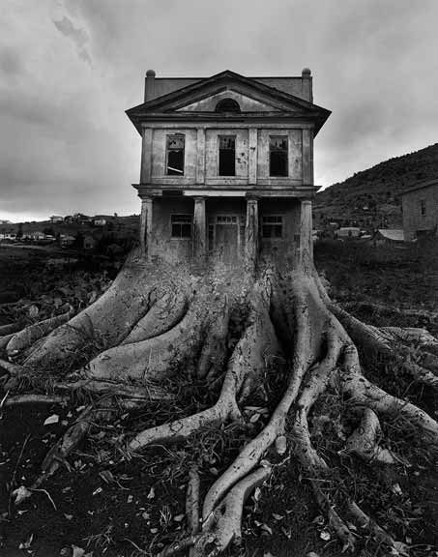
Assembling photographs from multiple negatives decades before digital tools like Photoshop were available. Using as many as seven enlargers to expose a single print, his darkroom skills allowed him to create evocative images that combined the realism of photography and the fluidity of our
dreams. As an artist who is not threatened by digital photography, he is convinced that it is equally difficult to produce great images no matter what tool you use.

Slide 25
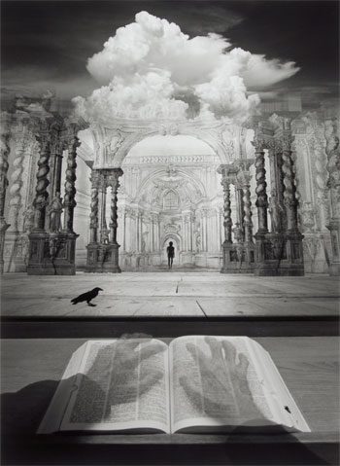
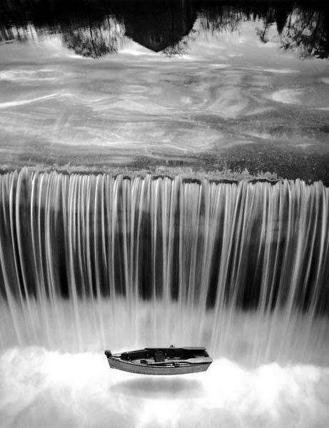

Slide 26
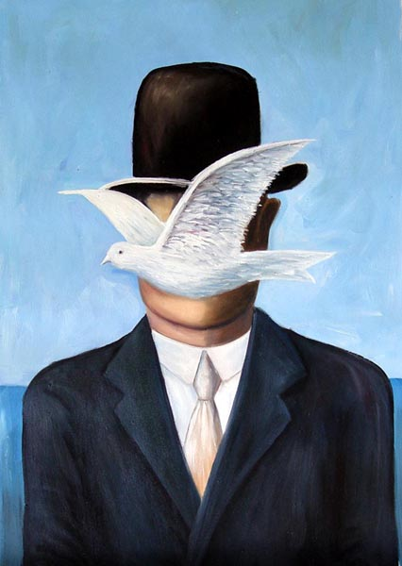
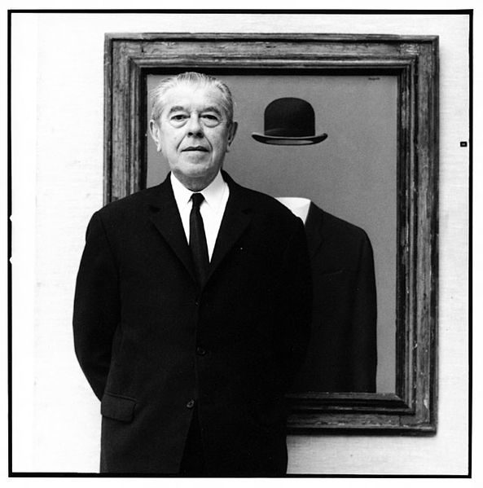
René
Magritte
Belgian 1898 - 1967
playful Surrealist
witty & though provoking imagery
The Man in the Bowler Hat, 1964
(oil on canvas)

Slide 27
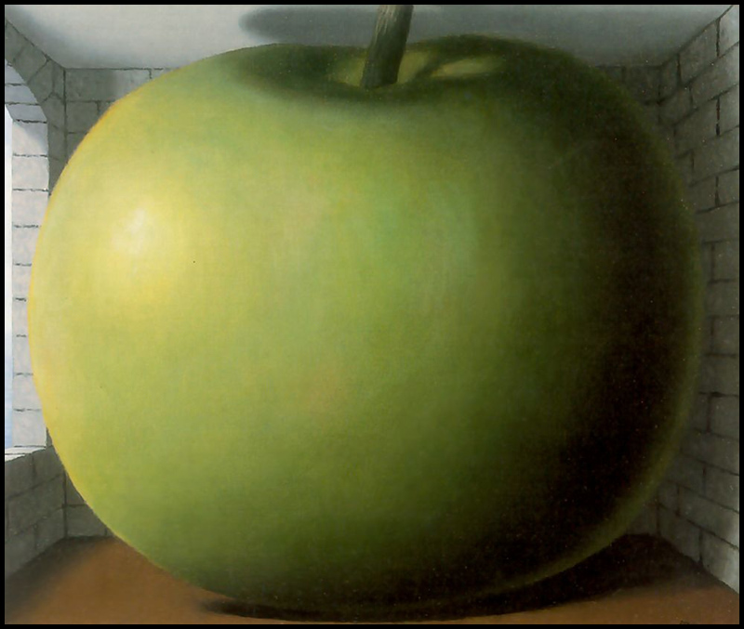
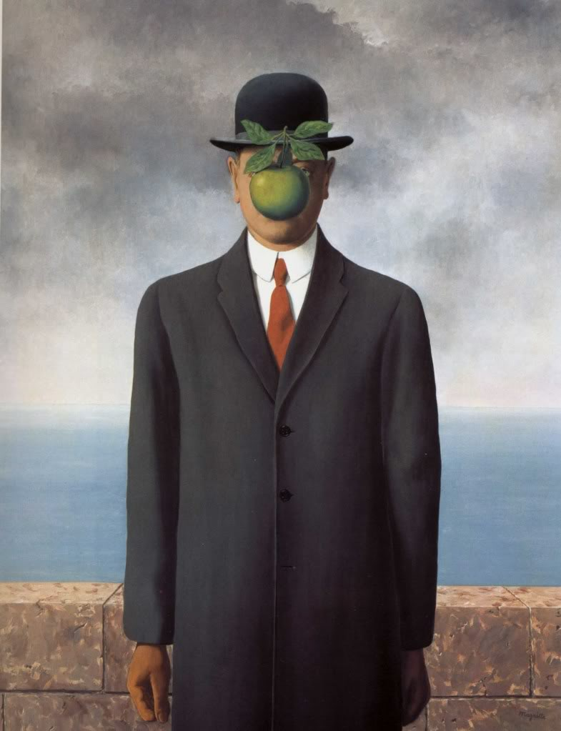
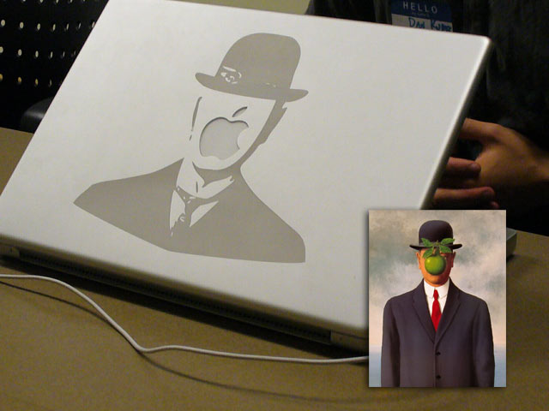
The Listening Room, 1952 (oil on canvas)
The Son of Man, 1964 (oil on canvas) 45” x 35”

Slide 28
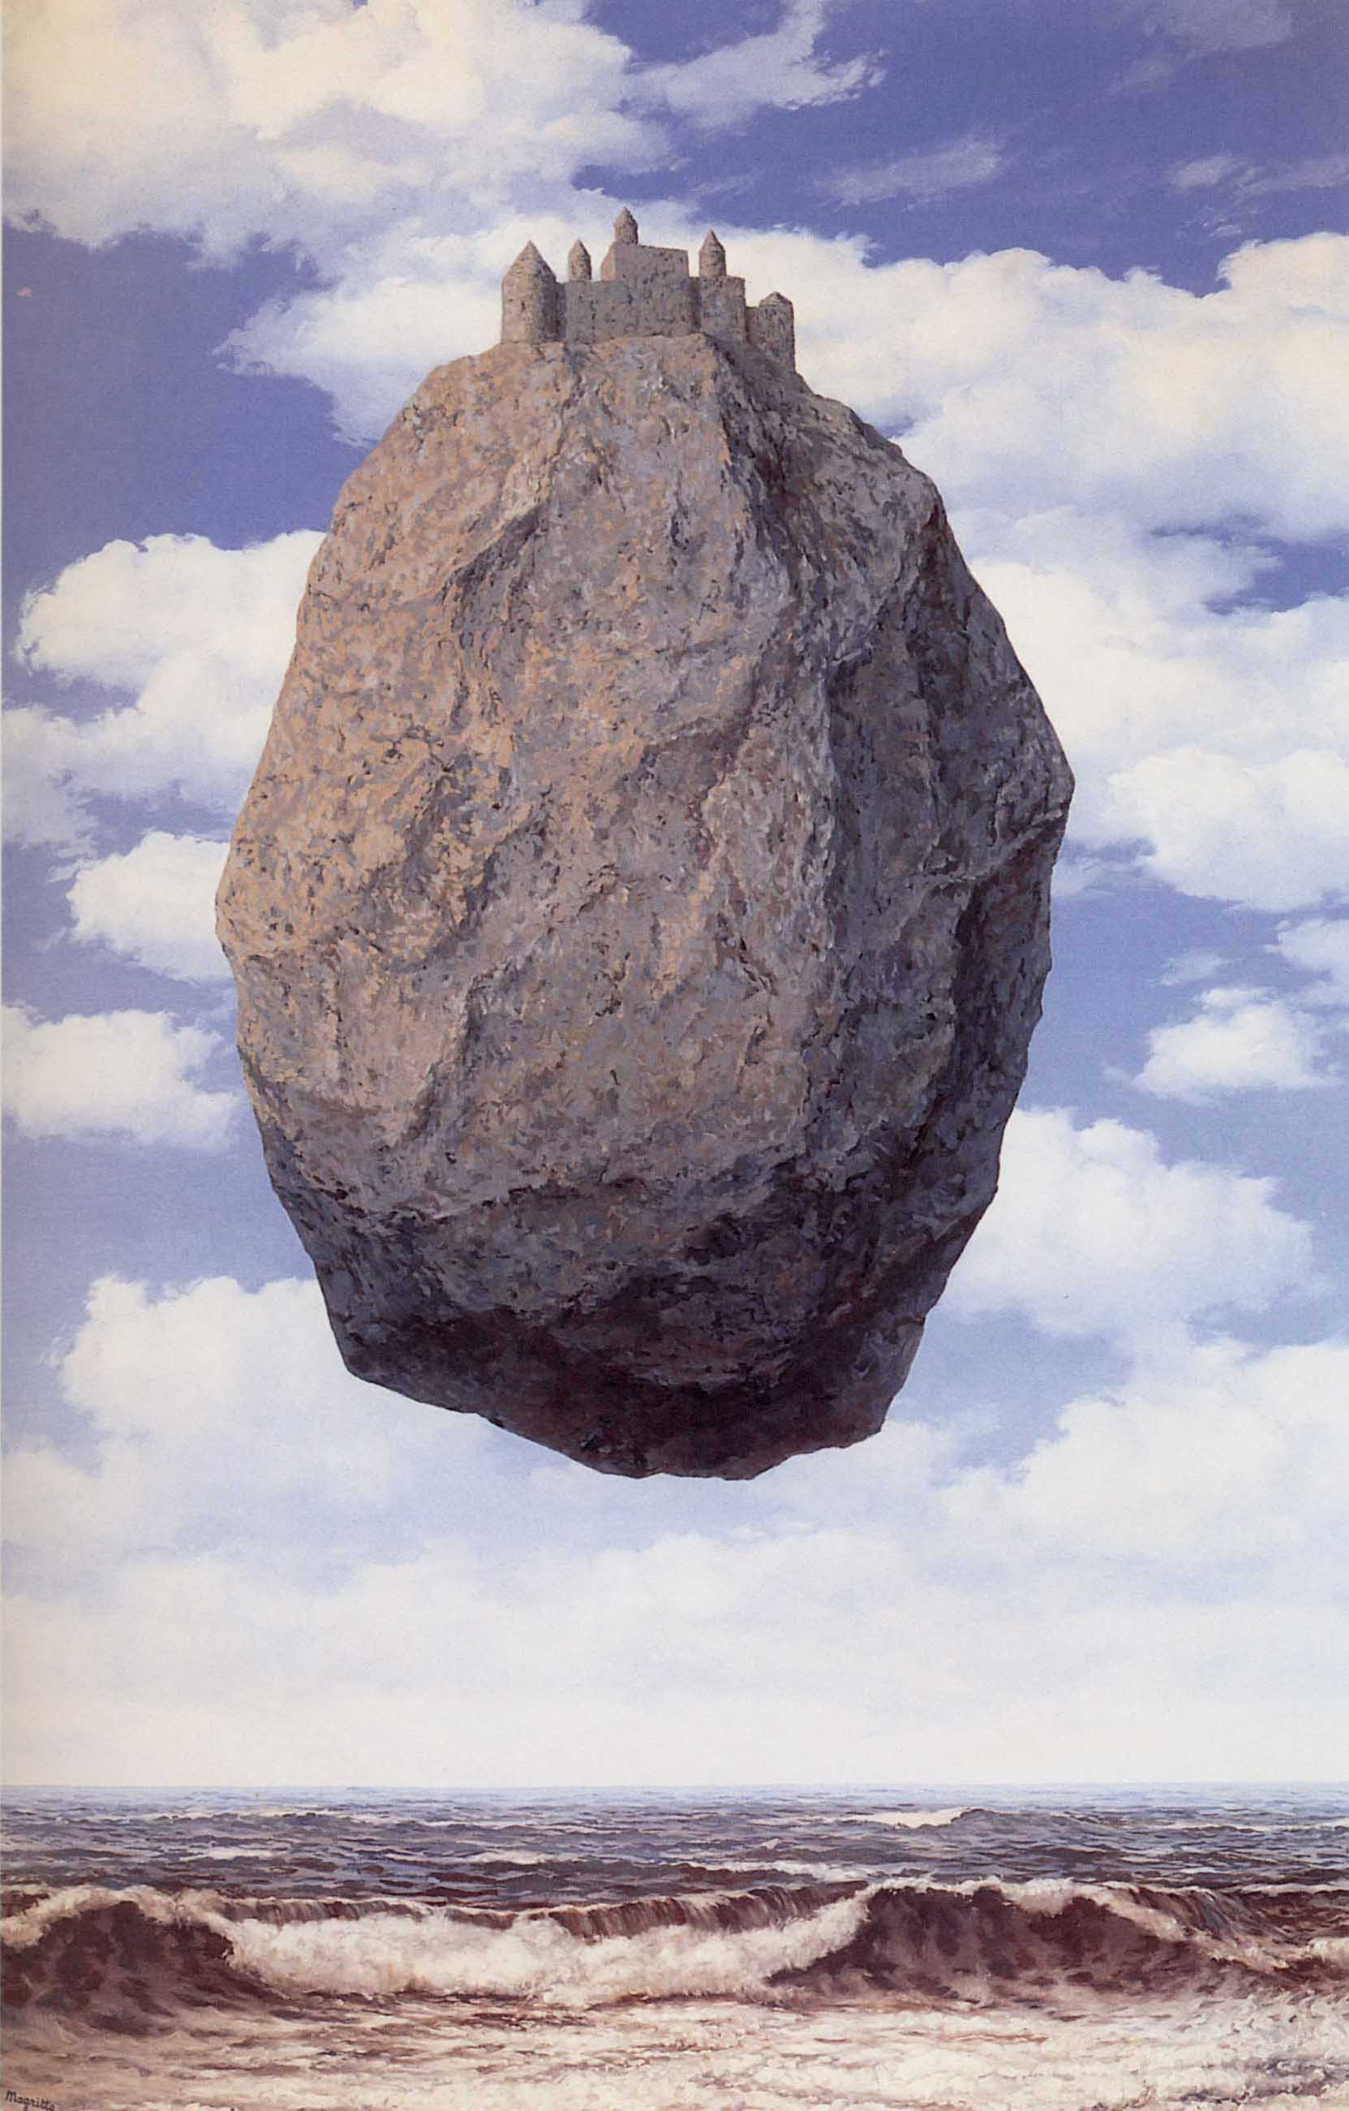
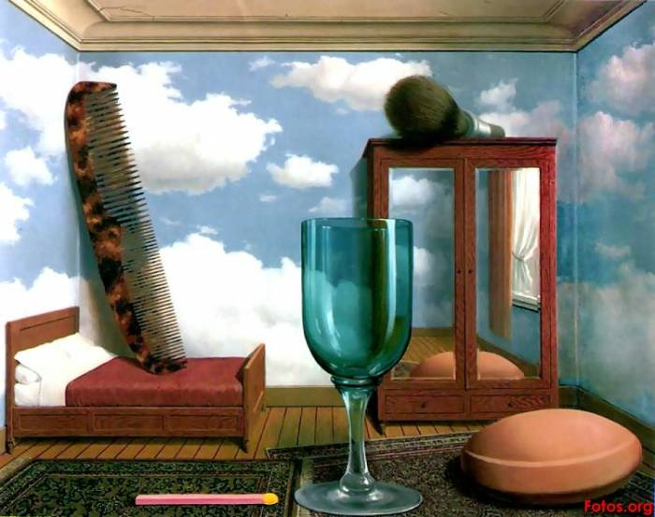
The Castle in the Pyrenees, 1959 (oil on canvas)
Personal Values, 1952 (oil on canvas) 80 x 100 cm

Slide 29
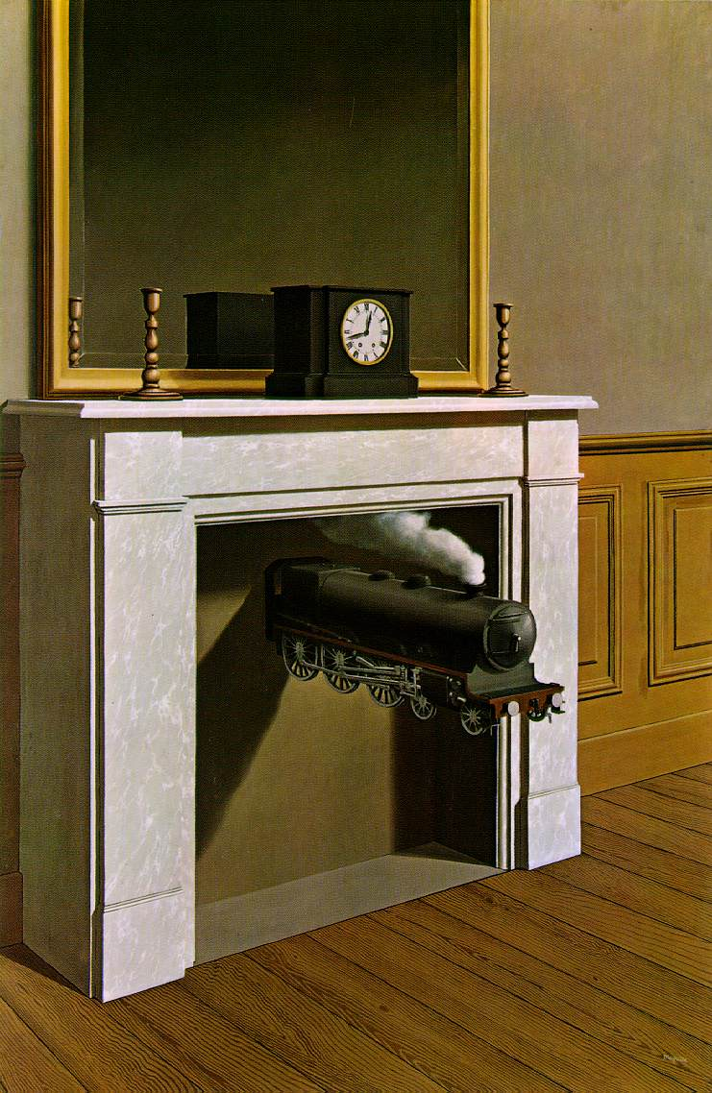
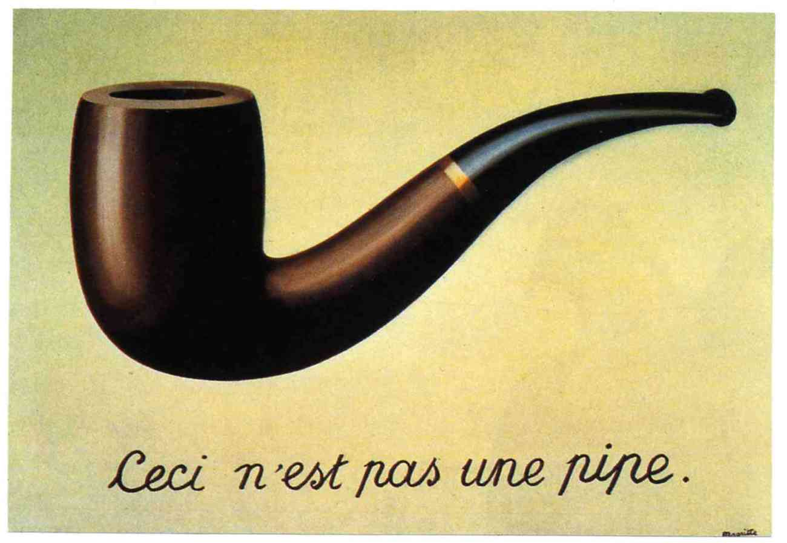
Time Transfixed, 1938
(oil on canvas) 58” x 39”
The Treachery of Images, 1929
(oil on canvas) 25” x 37”

Slide 30
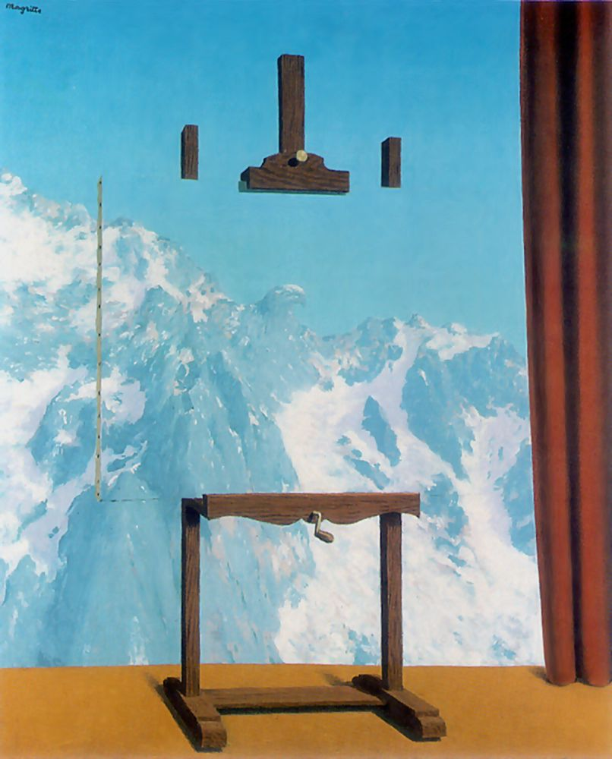
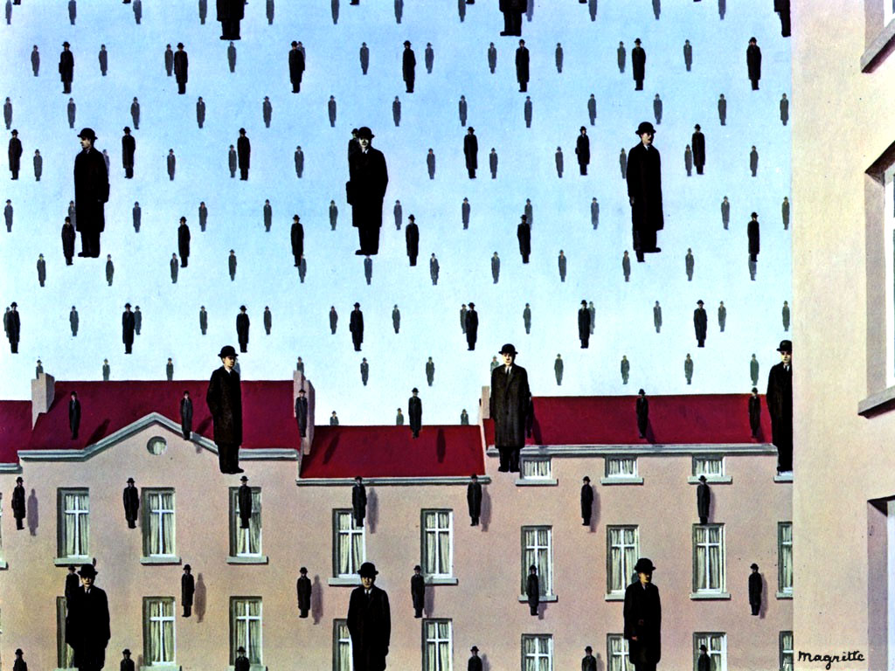
Call of the Peaks, 1942 (oil on canvas)
Golconda, 1953 (oil on canvas) 32” x 39”

